Slide 1


Predicting Employee Attrition
Submitted by-
Sweety Porwal
Gurpreet Kaur
Ankita Thakur

Slide 2

Objective and scope of the study
Factors that cause employees to leave the organization.
Predict which employee is likely to churn .
Explore factors that help the business to devise policies and attract back the right talent.

Slide 3




Analytical Approach
Data cleaning-
Exploratory data Analysis-
Model Comparison-
Model Selection

Slide 4
Data Source
The dataset for ‘IBM HR Analytics Employee Attrition & Performance’ has been picked which is available on IBM website.
Data contain records of 1470 Employees.
It has information about different attributes of an employee such as total number of companies worked in the past, total number of years at the company ,current roles and education level, monthly income, distance from home , etc. .
The target variable is Attrition.

Slide 5
Tools and Techniques
We have selected R as our analytical tool.
Included libraries such as ggplot, corrplot, gridextra,proc,rlist,rattle,rpart,etc,
Algorithm used Logistic Regression, decision tree.
Feature selection –Borouta check for validation.

Slide 6
Data cleaning
Removed Identifier Employee number in the dataset.
Removed the columns with same values : Employee Count, Standard Hours, Over18.
Transformation of data types into factor (9 columns): Job Satisfaction, Performance Rating , Relationship Satisfaction, Work Life Balance, Education, Environment Satisfaction , Job Involvement, Job Level, Stock Option Level.
Factor labelling: Work Life Balance, Job Satisfaction, Job Involvement, Environment Satisfaction, Relationship Satisfaction, Education.
No Missing value in the dataset.
Skewness treatment for the independent features.
Outlier fix.

Slide 7
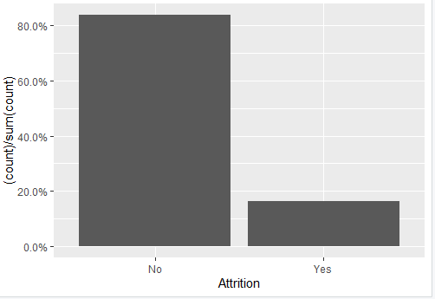
Exploratory Data Analysis
Check biaseness in target variable:
No=82.1%, yes= 17.9%

Slide 8
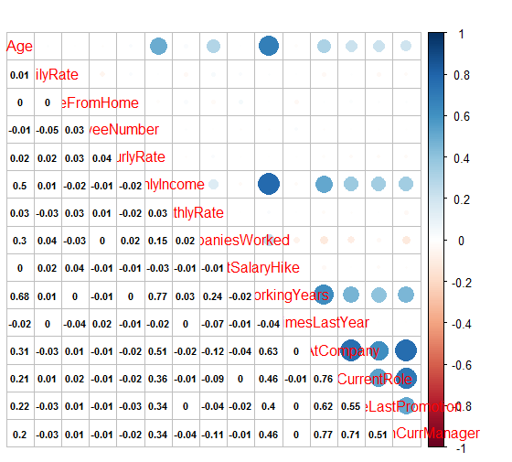
Correlation Matrix : Bivariate analysis which describes association between different variables
Correlation Matrix Plot :

Slide 9
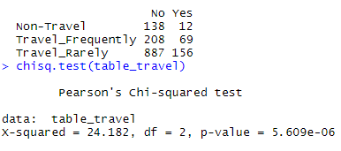
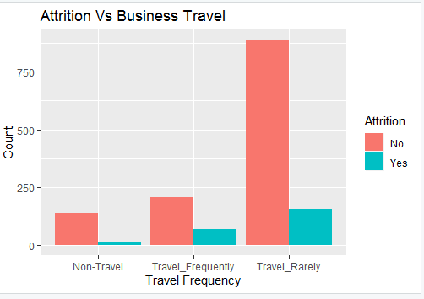
Relationship between Target(Attrition) & other variables
Attrition Vs Business Travel
The bar plot shows that employees who travel rarely do not frequently quit the job.
Thus, attrition is dependent on business travel, and the chi square test proves this as the p-value is less than alpha=0.05

Slide 10
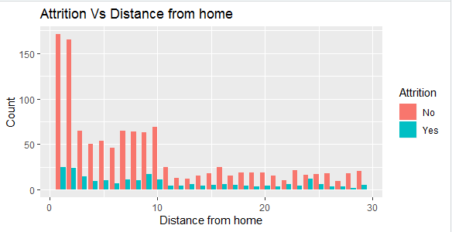
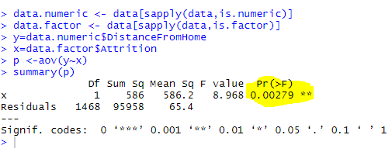
Attrition VS Distance from home
Bar plot shows that employees who lives in close proximity are the ones do not quit the job frequently.
As the p-value is less than alpha(0.05), the attrition of employee depends on distance from home.

Slide 11
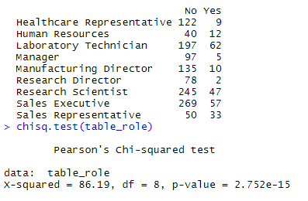
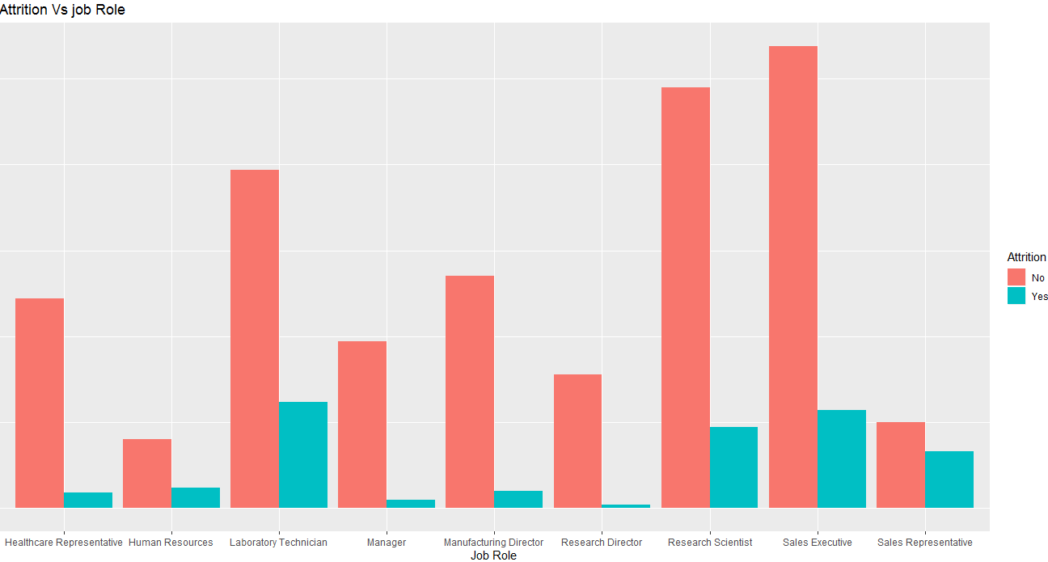
Attrition Vs Job Role
Bar plot shows that Sales executive are the one who goes most for attrition
As p-value is less than alpha, attrition depends on job role.

Slide 12
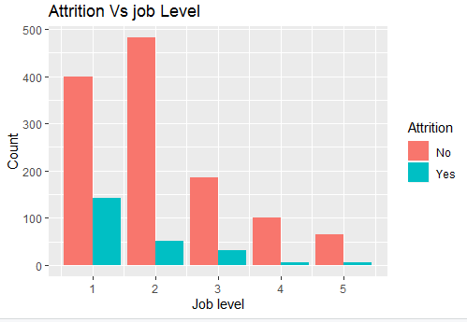
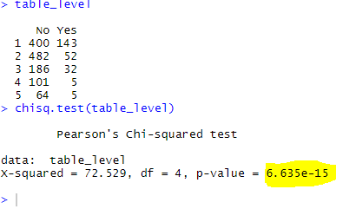
Attrition VS Job Level
The bar plot shows that employees at job level 2 are the one who go most for attrition.
#As p-value is less than alpha, attrition depends on job level.

Slide 13
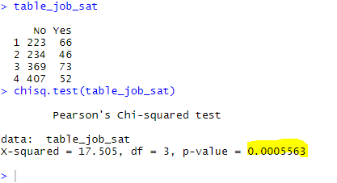
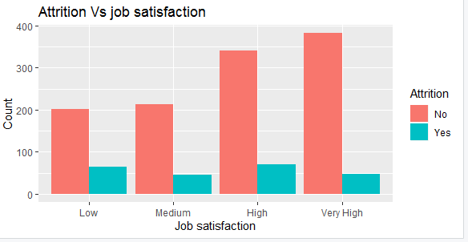
Attrition VS Job Satisfaction
Bar plot shows that employees with high job satisfaction don't go for attrition
As p-value is less than alpha, attrition depends on job satisfaction of employees.

Slide 14
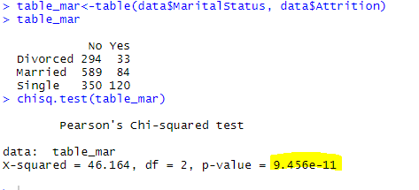
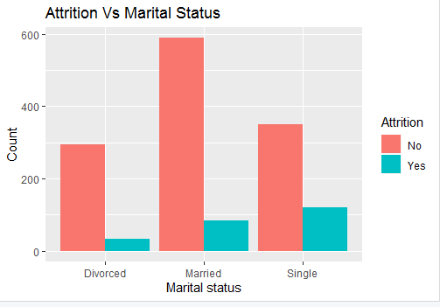
Attrition VS Marital Status
Bar plot shows that single people mostly go for attrition.
As p-value is less than alpha, attrition depends on the marital status of employees.

Slide 15
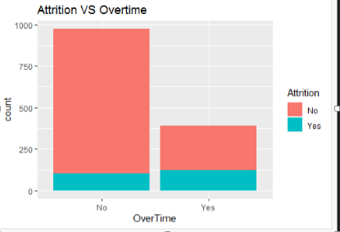
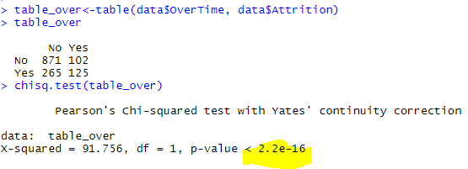
Attrition VS Overtime
As the bar plot shows, the less an employee works overtime ,the lower is attrition rate.
And the chi square test proves that.

Slide 16
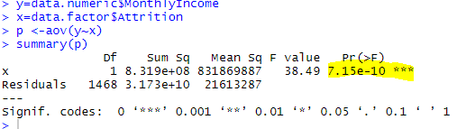
Attrition VS Monthly Income
Employees with low monthly income mostly goes for attrition,
Also Anova shows that attrition is highly dependent on monthly income.

Slide 17
Feature selection
Process where in those features are selected that are most contributing to the target variable.
Benefits of Feature selection:
Improves Accuracy
Improves the performance
Providing the better understanding of data

Slide 18

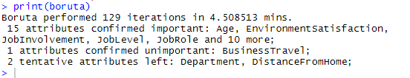
Boruta Algorithm for variable selection: Based on Random forest
Boruta find all features which are either strongly or weakly relevant to the target variable.
First, it duplicates the dataset, and shuffle the values in each column. These values are called shadow features.
Creates classification model with shadow and original attributes.
At every iteration, it checks whether a real feature has a higher importance than the best of its shadow features and constantly removes features which are deemed highly unimportant. i.e. it compares the z-score

Slide 19

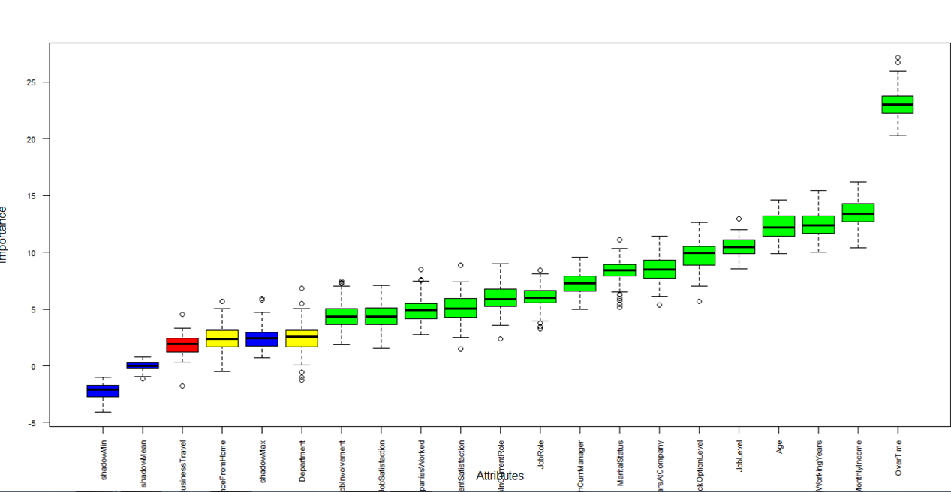

Slide 20


Boruta check continue….

Slide 21

Dropping Insignificant variables:
Current rows & coulmns

Slide 22
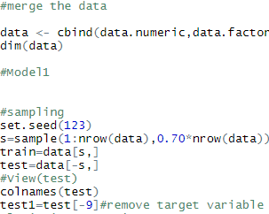
Splitting the data into train and test

Slide 23
Model Building
Model Building: Modeling means training a machine learning algorithm to predict the lables from the features, turning it for business need and validating it on hold out data.
Models Used for analysis:
Logistic Regression
Decision Tree

Slide 24

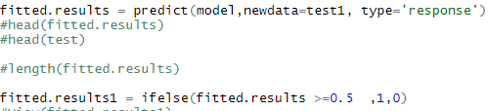
Logistic Regression Model
Model Building
Model Fitting

Slide 25
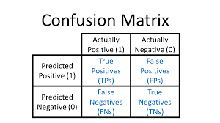
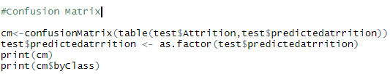

Confusion Matrix: Measure of Actual & Predicted value in tabular form
Standard table of confusion matrix
Confusion matrix as per Analysis:

Slide 26
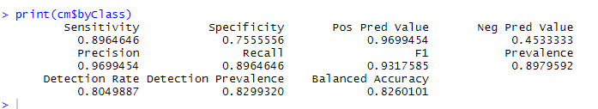
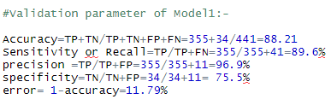
Accuracy, Precision, Recall & error rate
Calculated Manually

Slide 27
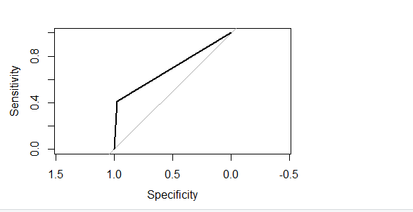
Receiver Operating curve (ROC) :
ROC determines accuracy of a classification model at a user defined threshold limit.
It determines accuracy using Area under curve(AUC)
Sensitivity (True Positive Rate) on Y-axis, 1-specificity(False positive rate ) on x-axis.

Slide 28
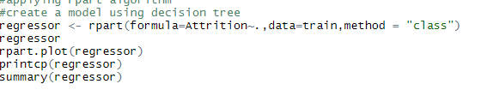
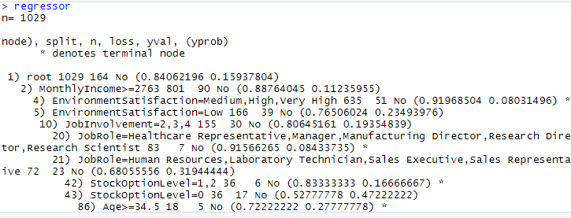
Decision Tree
Model Building:
Summary

Slide 29
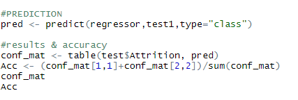
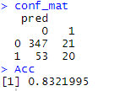
Model Testing
Confusion Matrix & Accuracy

Slide 30
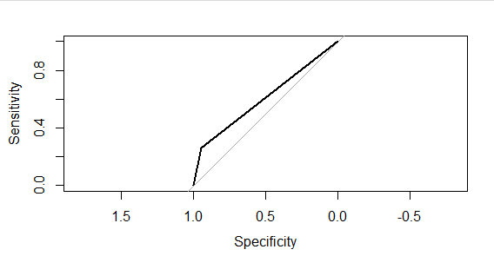

ROC Curve
AUC

Slide 31
Model Comparison & Selection
Model | Accuracy | Sensitivity | Specificity | Error | AUC
Logistic Regression | 88.2% | 79% | 89% | 11.7% | 0.77
Decision Tree | 83.2% | 26% | 94.5% | 16.8% | 0.60
Model Selection :
Logistic Model with high accuracy and AUC

Slide 32
Key Findings
The dataset does not have any missing values or any redundant features.
Key features that are contributing more towards target variable are distance from home,
Overtime, monthly income, environment satisfaction, business travel .
From business perspective the company has to more focus on training the employees,
Transportation allowance ,project allocation properly to avoid overtime ,employee satisfaction to retain the employees as hiring new staff & training them will cost more to company.

Slide 33
Recommendations
Transportation should be provided to employees living in the same area, or else transportation allowance should be provided.
▪ Plan and allocate projects in such a way to avoid the use of overtime.
▪ Employees who hit their two-year anniversary should be identified as potential employees having a higher-risk of leaving.
▪ Gather information on industry benchmarks to determine if the company is providing competitive wages.

Slide 34


